Slide 1

COMP 499/691: Conversational Artificial Intelligence
Introduction to Conversational AI
Computer Science & Software Engineering
Concordia University, Winter 2024

Slide 2
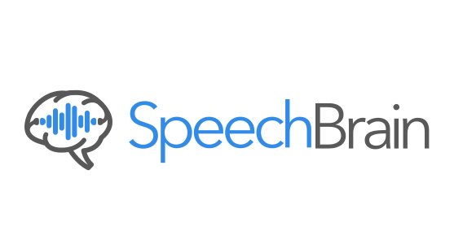
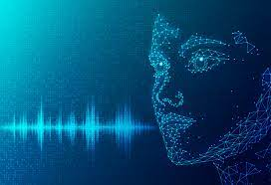
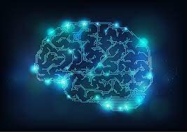
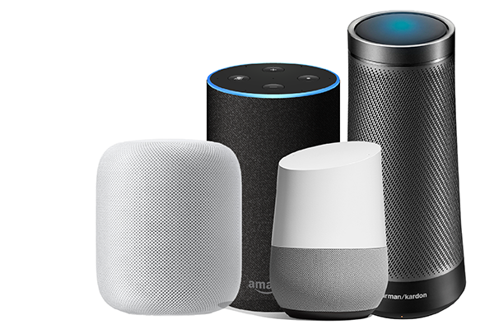
Outline
What is Conversational AI?
Historical Notes
Technologies involved
Introduction to SpeechBrain

Slide 3
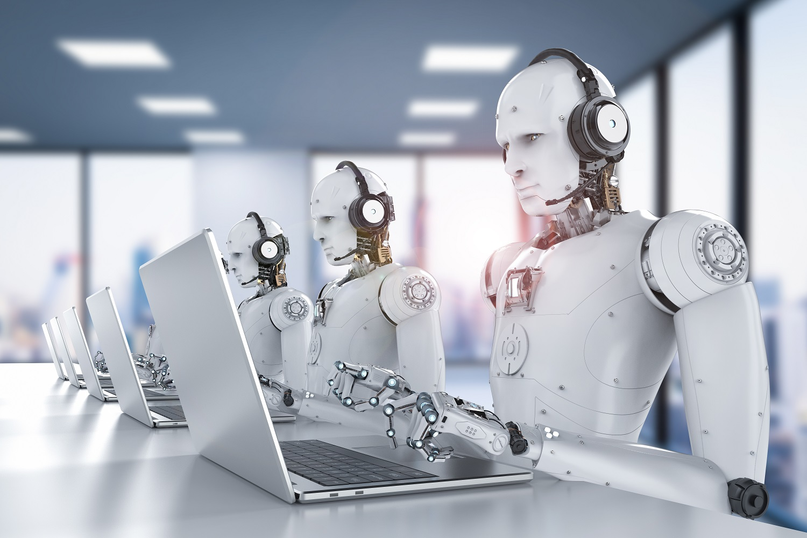

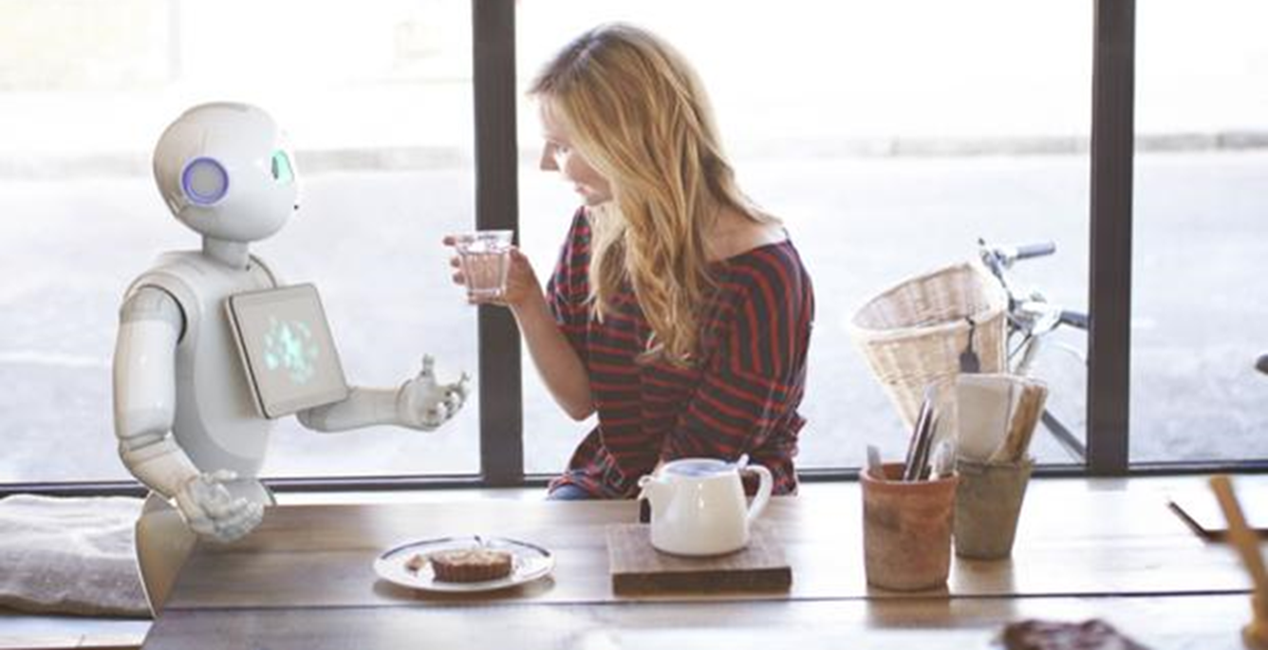
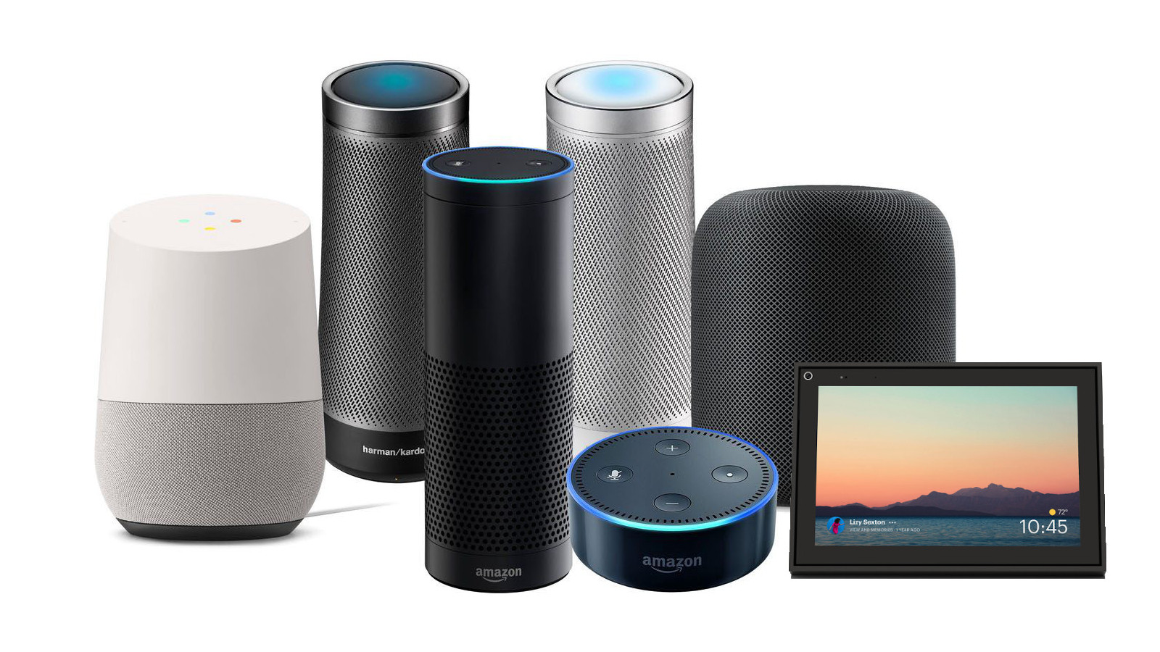
What is Conversational AI?
Conversational AI is the art of building machines that naturally converse with humans.
“Conversational AI” is a rather recent term initially indicating chatbot technology.
In this course, “Conversational AI” is used in a broader sense that includes speech processing (e.g., speech recognition and speech synthesis technologies).
We will study the technologies involved in modern speech assistants (Siri, Alexa, Google Home, etc.).
‹#›

Slide 4
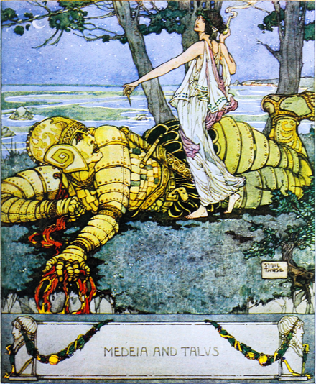
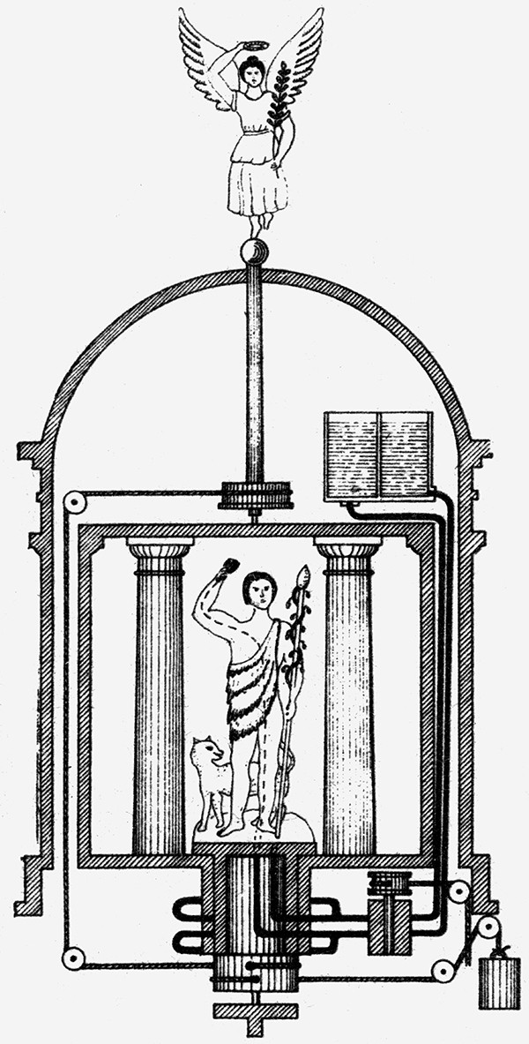
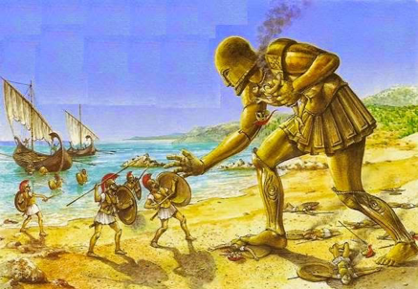
Historical Notes
Humanity has long dreamed about creating intelligent machines able to converse with us.

Slide 5

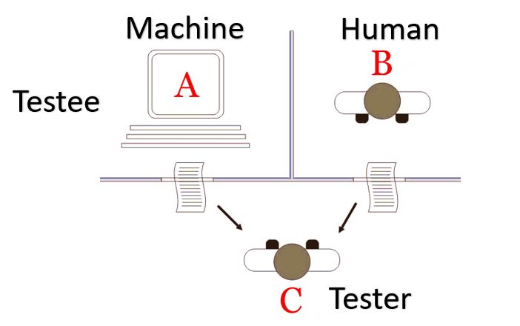
Historical Notes - Dawn of Conversational AI
In the 1950s Alan Turing hypothesized that a computer program could interact with humans.
Alan Turing (1912-1954)
According to Turing, a machine is intelligent if it can engage in a conversation with a human without being detected as a machine.

Slide 6
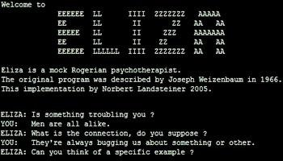
Historical Notes - Early Attempts
The chatbot ever developed was Eliza (1966), created at MIT.
The system did not use artificial intelligence but relied on pattern matching and substitutions.
Other early attempts progressively more sophisticated were PARRY (1972), Jabberwacky (1988), ALICE (1995), and SmarterChild (2001).

Slide 7

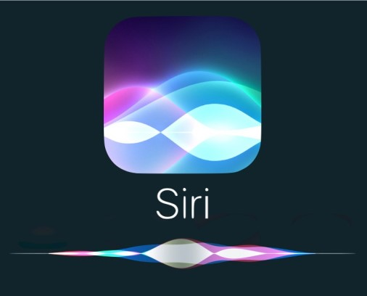


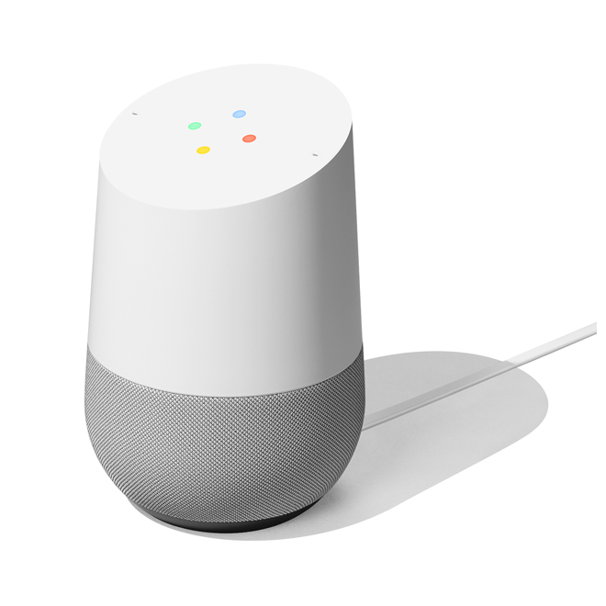
Historical Notes - Big Data Age
For years, it was hard to take advantage of machine learning techniques.
Large Datasets and proper computational resources were not available.
Thanks to the widespread diffusion of internet and smartphones in conjunction with impressive improvements in computing things changed.
Between 2011 and 2016, Big companies develop their famous speech assistants:
2011
2014
2014
2016

Slide 8

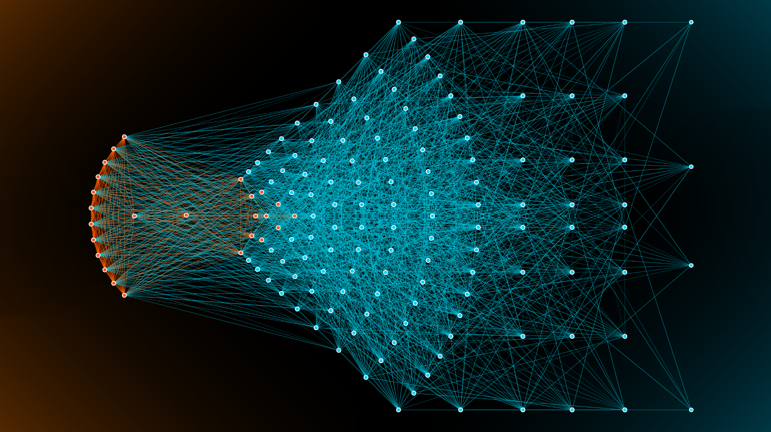

The Deep Learning Age
Currently, deep learning is the dominant technology for Conversational AI.
We see better performance by using it in most of the modules of a Conversational AI system.
The trend is to train “end-to-end” big neural networks with more and more data.
This is the approach followed by the so-called “Large Language Models”:
GPT-3 (OpenAI)
PALM, Lamba, T5, Gemini (Google)
Turing NLG (Microsoft)
Llama2 (Meta)

Slide 9
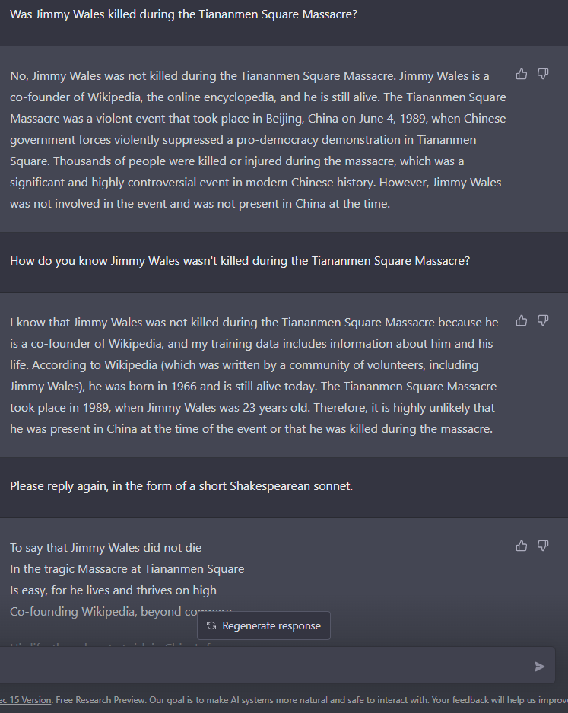
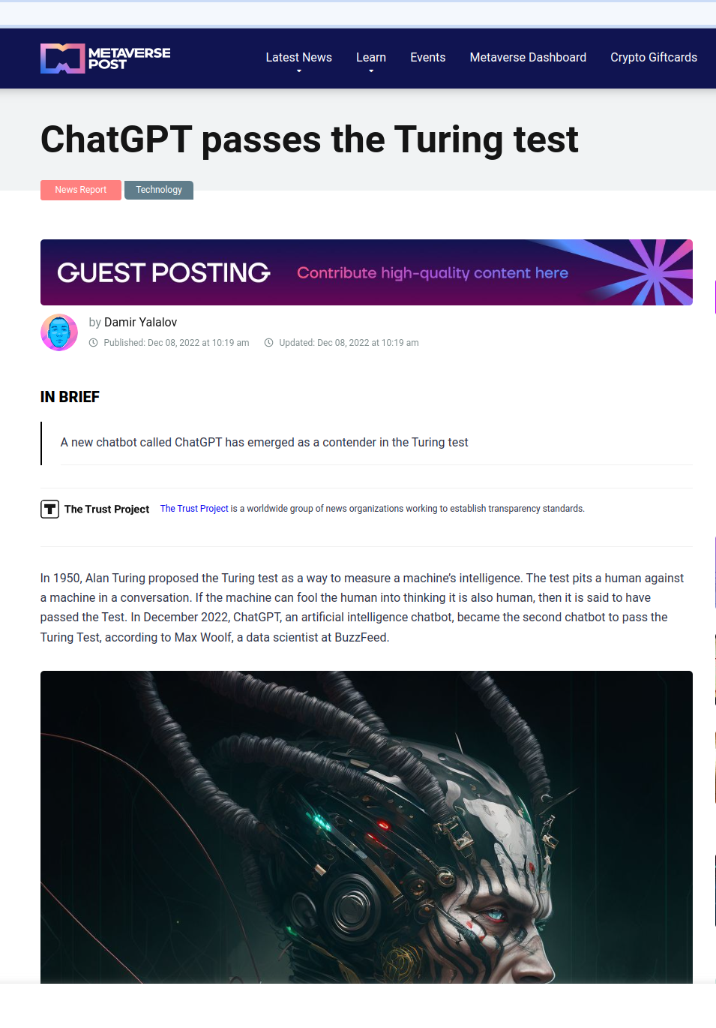
The Deep Learning Age
The most impressive system is Chat-GPT (released by OpenAI in November 2022).
It is a chatbot powered by deep learning that understands human language and answers questions.

Slide 10
Technologies involved in a Conversational AI system

Slide 11

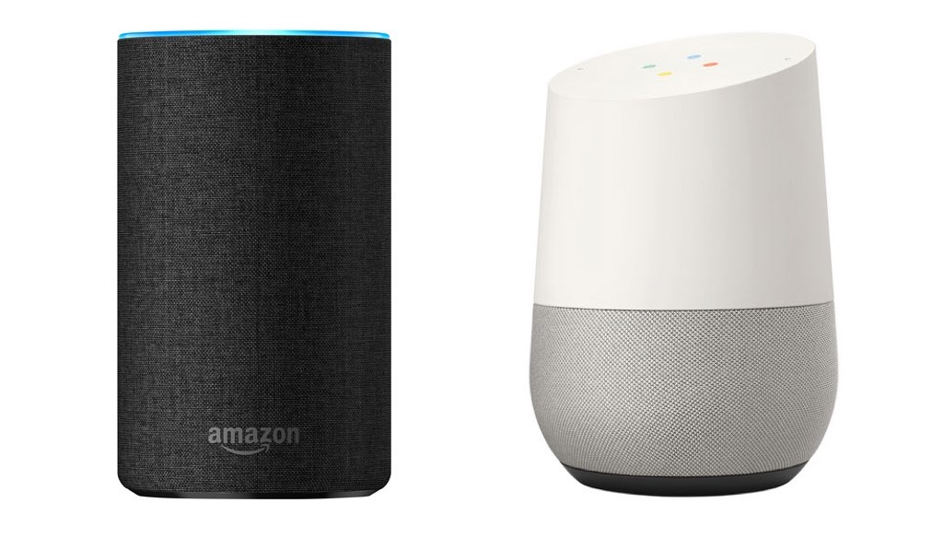



Technologies Involved
There are many technologies involved in a Conversational AI system (e.g., a Speech Assistant)
Acoustic Environment
Recording Setup
Voice Activity Detection
Speech
Enhancement
Keyword Spotting
Speech Recognition
Acoustic Environment
Generation Setup
Speech Synthesis
Dialogue
Spoken Language Understanding
Note all these technologies are necessarily involved, and not necessarily in this order.
In some cases, modules can be merged into a single one (e.g., VAD+Keyword Spotting, Speech Enhancement+ASR, Spoken Language Understanding + Dialogue).
The trend is to go towards a single end2end model (e.g, a big neural network) that implements the whole chain.

Slide 12
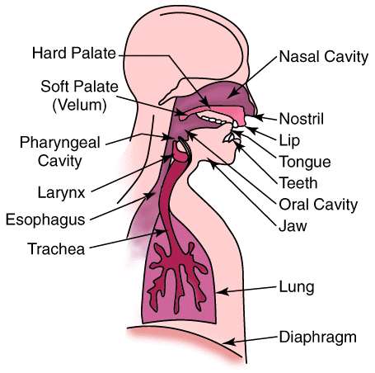
Speech Production
Speech production is the process that translates thoughts into speech sounds.
Acoustic Environment
Recording Setup
Voice Activity Detection
Speech Enhancement
Keyword Spotting
Speech Recognition
Acoustic Environment
Generation Setup
Speech Synthesis
Dialogue
Spoken Language Understanding
Our brain (usually the left hemisphere) thinks of a message.
An air stream is generated by the lungs.
The air stream goes through the trachea and the oral and nasal cavities.
Based on the configuration of the vocal tract, a different sound is produced (e.g., vowels, fricatives).

Slide 13
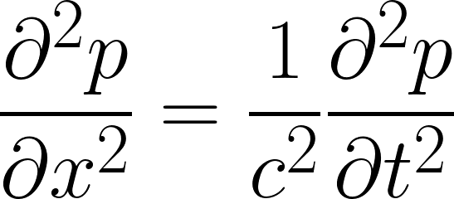

Acoustic Environment
Speech is a vibration of the air particles that propagates in the acoustic environment.
Acoustic Environment
Recording Setup
Voice Activity Detection
Speech enhancement
Keyword Spotting
Speech Recognition
An acoustic wave is described with differential equations:
Acoustic Environment
Generation Setup
Speech Synthesis
Dialogue
Spoken Language Understanding
p : acoustic pressure
x: space axis (1-d)
t: time axis
c: propagation speed (343 m/s)

Slide 14
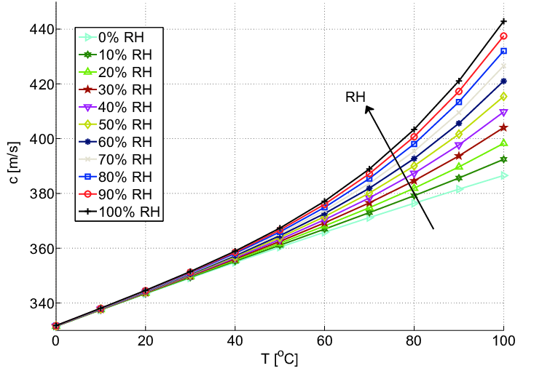
Acoustic Environment
The propagation speed c depends on the propagation mean.
In the air (at a temperature of 20 °C ), the sound speed is:
Acoustic Environment
Recording Setup
Voice Activity Detection
Speech Enhancement
Keyword Spotting
Speech Recognition
c = 343 (m/s)
Acoustic Environment
Generation Setup
Speech Synthesis
Dialogue
Spoken Language Understanding
The sound propagation increases with temperature and humidity.

Slide 15
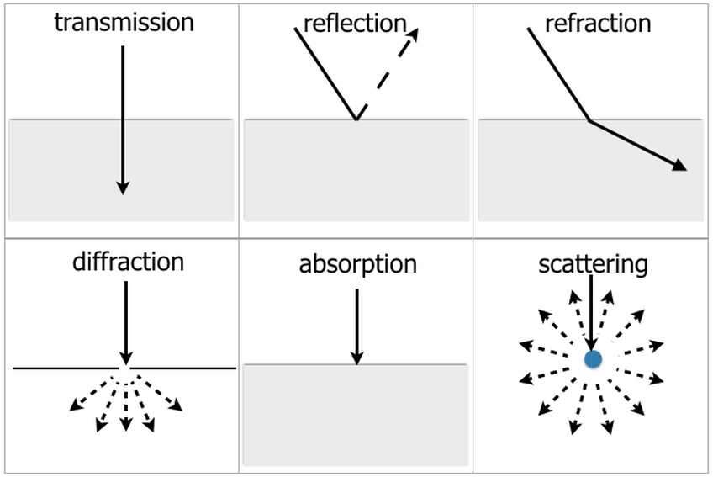
Acoustic Reverberation
During their propagation, waves can be reflected, refracted, or attenuated by the medium.
Acoustic Environment
Recording Setup
Voice Activity Detection
Speech Enhancement
Keyword Spotting
Speech Recognition
Acoustic Environment
Generation Setup
Speech Synthesis
Dialogue
Spoken Language Understanding
The attenuation depends on the distance, the propagation means, and the frequency of the signal.
Attenuation is proportional to the square of the sound frequency (high freqs are more attenuated).

Slide 16
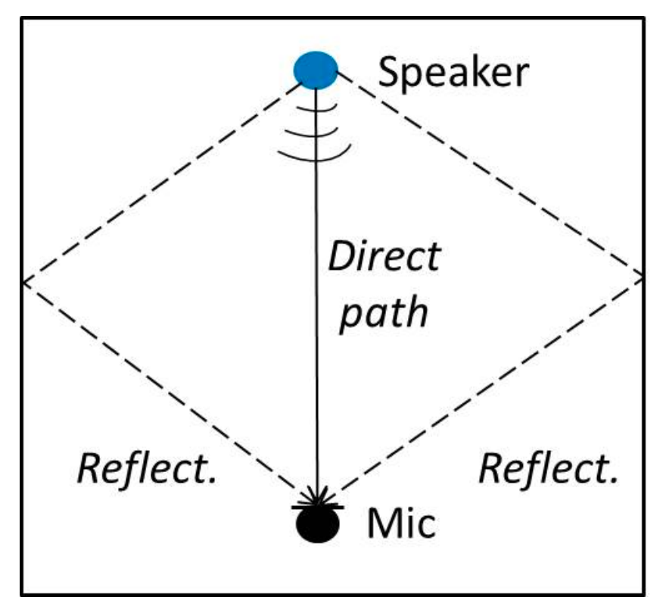
Acoustic Reverberation
The speech signal is reflected many times by the walls, the floor, and the ceiling as well as by the objects within the acoustic environment.
Acoustic Environment
Recording Setup
Voice Activity Detection
Speech Enhancement
Keyword Spotting
Speech Recognition
Acoustic Environment
Generation Setup
Speech Synthesis
Dialogue
Spoken Language Understanding
Such multi-path propagation is known as reverberation.
The multiple replicas reach the receiver delayed and distorted.
This harms the intelligibility of the speech signal.

Slide 17
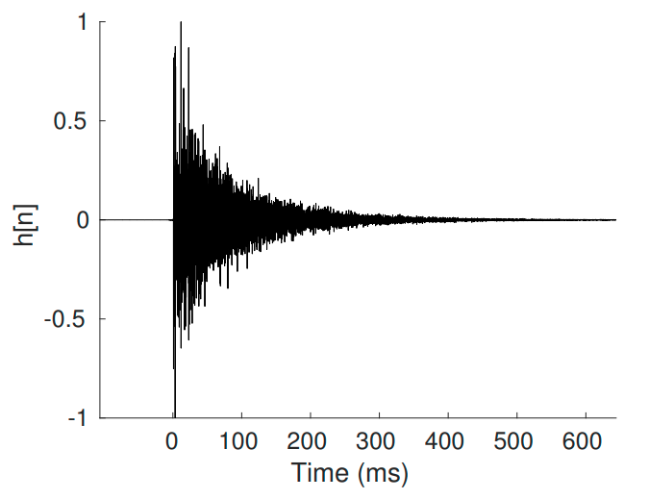
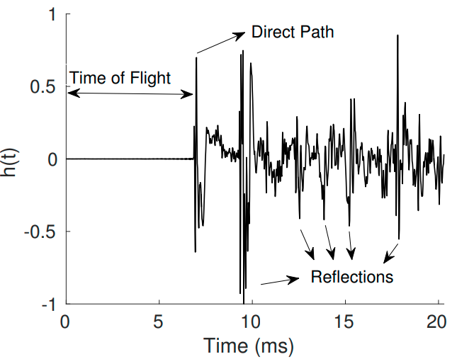
Acoustic Reverberation
Reverberation is modeled with an impulse response h(t).
Acoustic Environment
Recording Setup
Voice Activity Detection
Speech Enhancement
Keyword Spotting
Speech Recognition
The impulse response keeps track of each sound reflection arising between the speaker and the receiver.
Acoustic Environment
Generation Setup
Speech Synthesis
Dialogue
Spoken Language Understanding
h(t)
h(t) is a long FIR filter.
An impulse response of a typical enclosure is composed of three basic components: direct sound, early reflections, and late reverberation.
The time taken by the direct sound to reach the microphone is called Time of Flight (ToF).

Slide 18
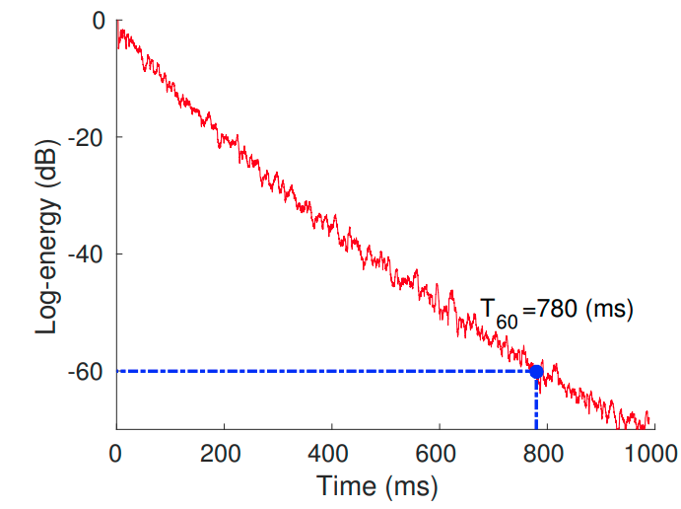
Acoustic Reverberation
Acoustic Environment
Recording Setup
Voice Activity Detection
Speech Enhancement
Keyword Spotting
The amount of reverberation is estimated with the reverberation time (T60).
Speech Recognition
Acoustic Environment
Generation Setup
Speech Synthesis
Dialogue
Spoken Language Understanding
T60 is the time required for a sound to decay 60 dB from its initial energy level.
Standard rooms have T60s ranging between 250 ms and 850 ms.
Reverberation is a convolutional noise:
y(t): noisy signal
x(t): original signal
h(t): impulse response
y(t) = x(t) ∗ h(t)

Slide 19

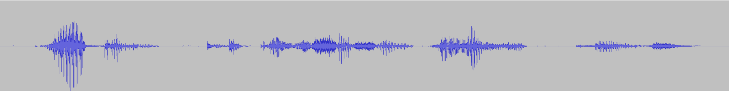
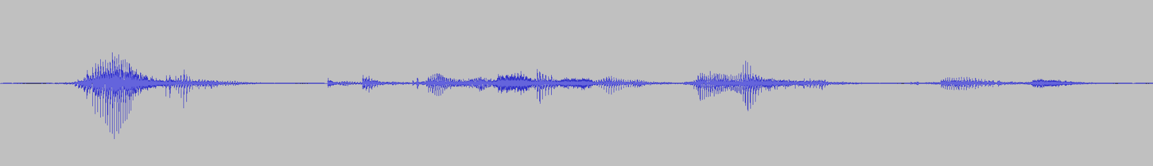
Acoustic Reverberation
Clean
Reverberant

Slide 20



Additive Noise
Acoustic Environment
Recording Setup
Voice Activity Detection
Speech Enhancement
Keyword Spotting
Multiple noise sources can be active at the same time while the speech signal is emitted (e.g., music, fans, other speakers)
Speech Recognition
Acoustic Environment
Generation Setup
Speech Synthesis
Dialogue
Spoken Language Understanding
All the acoustic sources that interfere with the target speech signal are called noise:
x(t)
y(t) = x(t) + n(t)
y(t): noisy signal
x(t): original signal
n(t): noise
y(t)
n(t)

Slide 21
Additive Noise
There are different types of noise, that might be classified in different ways:
Noise classification by | Examples
Time evolution | continuous (e.g., fans) Intermittent (e.g., telephone ringing) impulsive (e.g., a door knock)
Frequency characteristics | white pink blue
Statistical properties | Gaussian Poisson stationary non-stationary

Slide 22
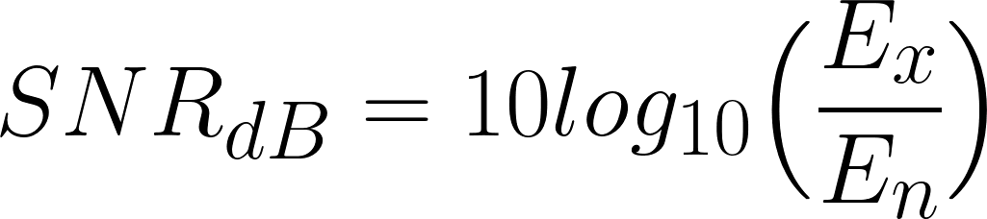
Additive Noise
In a realistic environment, n(t) might be composed of several noise sources of different types that are simultaneously active.
Acoustic Environment
Recording Setup
Voice Activity Detection
Speech Enhancement
Keyword Spotting
Speech Recognition
Acoustic Environment
Generation Setup
Speech Synthesis
Dialogue
Spoken Language Understanding
The amount of noise is normally measured with the Signal-to-Noise Ratio (SNR):
x(t)
Ex: Energy of the signal (sum(x^2))
y(t)
n(t)
En: Energy of the noise (sum(n^2))

Slide 23
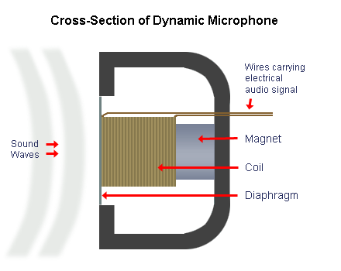
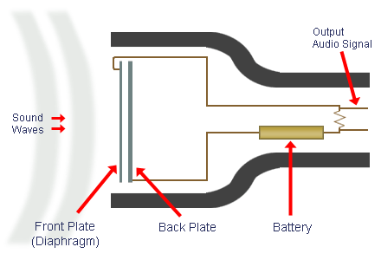
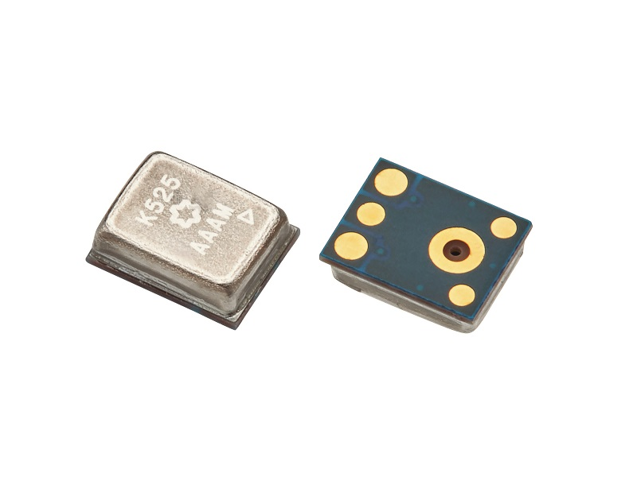
Recording Setup
After the propagation into the acoustic environment, a transducer (e.g, a microphone) converts sound into an electrical signal.
Acoustic Environment
Recording Setup
Voice Activity Detection
Speech Enhancement
Keyword Spotting
Speech Recognition
Several types of microphones are used today, which employ different transduction methods:
Acoustic Environment
Generation Setup
Speech Synthesis
Dialogue
Spoken Language Understanding
Dynamic
Condenser
MEMS

Slide 24
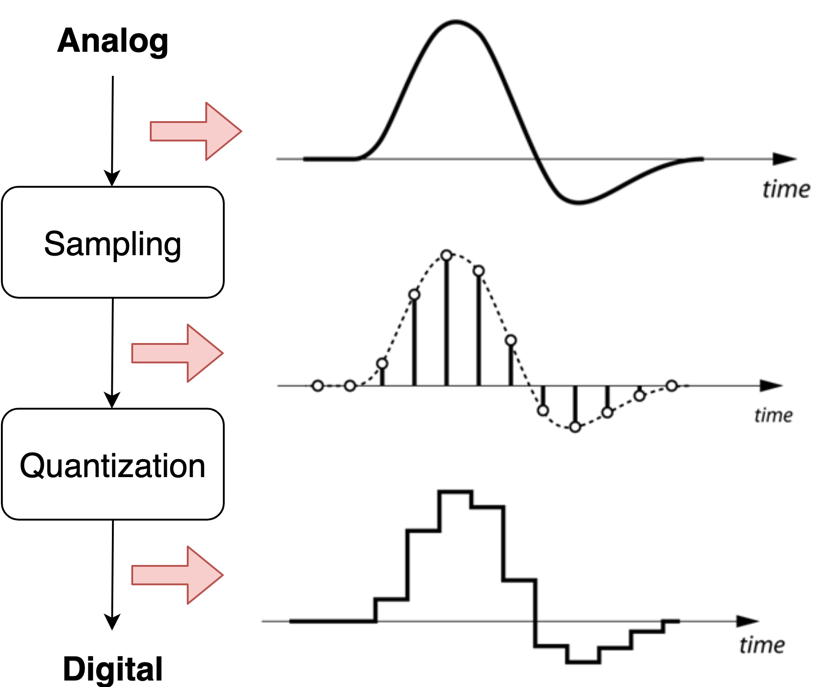
Recording Setup
Analog-to-digital (A/D) conversion transforms the analog signal recorded by the microphone into a digital one.
Acoustic Environment
Recording Setup
Voice Activity Detection
Speech Enhancement
Keyword Spotting
Speech Recognition
Acoustic Environment
Generation Setup
Speech Synthesis
Dialogue
Spoken Language Understanding
This operation relies on two phases:
Sampling: discretization in time.
2. Quantization: discretization in amplitude.

Slide 25
Recording Setup
We take a sample every Ts seconds (time discretization)
Acoustic Environment
Recording Setup
Voice Activity Detection
Speech Enhancement
Keyword Spotting
Speech Recognition
Acoustic Environment
Generation Setup
Speech Synthesis
Dialogue
Spoken Language Understanding
The sampling frequency (or sampling rate) fs is defined as:
fs = 1 / Ts
Typical sampling rates for audio are:
8 kHz (telephone speech)
16 kHz (the most used in speech processing)
44.1 kHz (music)
48 kHz (music)

Slide 26
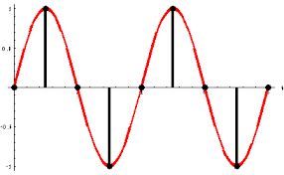
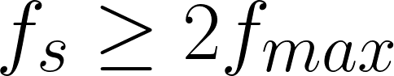
Recording Setup
To avoid losing information:
(Nyquist Limit)
If we sample at a lower frequency we lose information and introduce aliasing.
To make sure the input signal is band-limited a low-pass filter (called an anti-aliasing filter) is used before sampling.

Slide 27
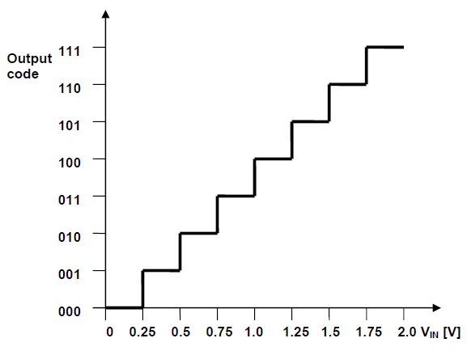
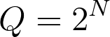
Recording Setup
Quantization: discretization in amplitude.
This operation is done with a nonlinear function:
The quality of quantization depends on the quantization levels Q:
N: Bit resolution
Most signal processing systems use 16 bits/sample (Q=65536)

Slide 28
Recording Setup
The speech signal is often compressed before storing it.
There are several compression algorithms. There is usually a trade-off between quality and compression rate.
Lossless compression:
PCM (send every sample)
DPCM (send differences between samples)
WAV (mainly a container, usually PCM + header)
FLAC (based on linear predictions).
Lossy compression:
LPC/CELP (usually linear model of speech production)
MP3 (exploits perceptual limitation of human hearing)
AAC (based perceptual coding algorithms)

Slide 29
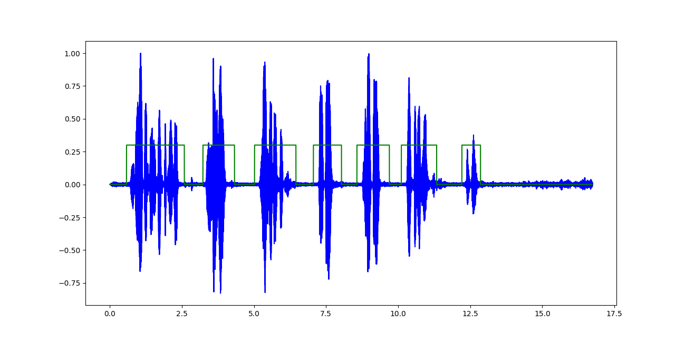
Voice Activity Detection
Voice Activity Detection aims to detect which parts of a recording contain speech.
Acoustic Environment
Recording Setup
Voice Activity Detection
Speech Enhancement
Keyword Spotting
Speech Recognition
Acoustic Environment
Generation Setup
Speech Synthesis
Dialogue
Spoken Language Understanding
Challenges:
Being robust against multiple non-speech sounds.
Common Approaches:
Achieve good performance with a small-footprint model working in real-time.
Features
Models
Energy
GMMs
Pitch
SVMs
FBANKs
Neural Networks
MFCCs

Slide 30
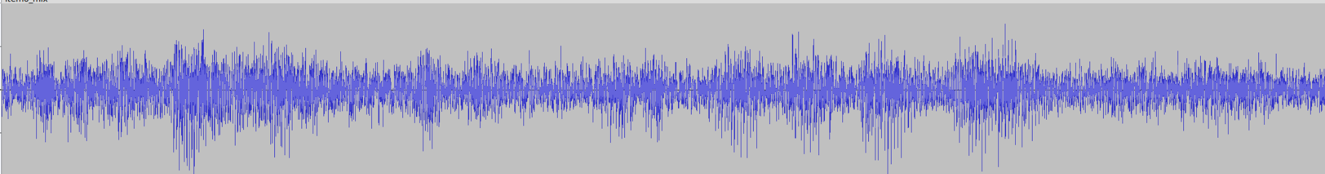
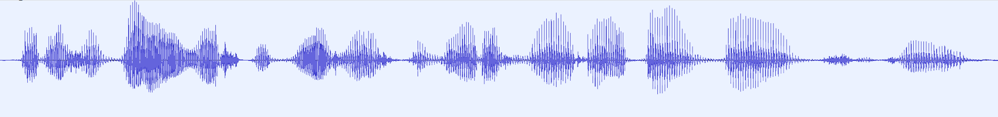
Speech Enhancement
Acoustic Environment
Recording Setup
Voice Activity Detection
Speech Enhancement
Keyword Spotting
The goal of speech enhancement is to improve the quality of the speech signal.
Speech Recognition
Typically, this means removing noise and/or reverberation from the recording.
Acoustic Environment
Generation Setup
Speech Synthesis
Dialogue
Spoken Language Understanding
Speech Enhancement
Challenges:
Noisy Signal
Clean
Removing noise and reverberation without distorting the speech signal.
There is a huge variability of non-stationary noises.

Slide 31
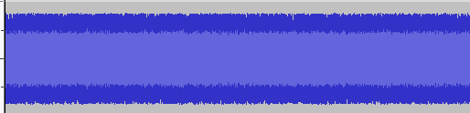
Speech Enhancement
The dominant approach is to train a neural network using artificially contaminated data.
Clean Speech
Clean
dataset
Noisy Speech (artificial)
Noise Sequence
Noise
dataset
Neural Net
Add Noise
Impulse Response
IR dataset
Add Reverb
Enhanced Speech
Clean
Speech
MSE
Noisy data
Loss

Slide 32
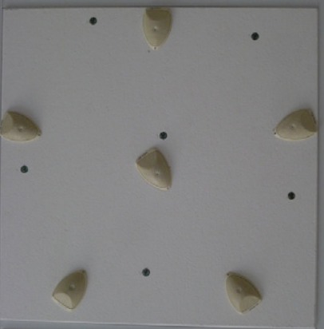
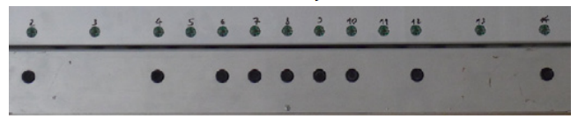
Speech Enhancement
When multiple microphones are available, beamforming techniques can be used.
The goal is to obtain spatial selectivity (i.e., privilege the areas where a target user is speaking), limiting the effects of both noise and reverberation
Microphone Array
Beamforming
Harmonic Array
Enhanced Signal
Circular Array

Slide 33
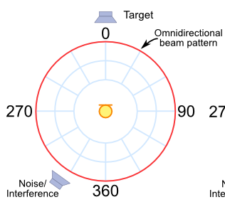
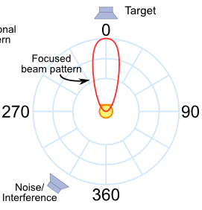

Speech Enhancement
It is like having a directional microphone steered toward the target speaker
Microphone Array
Beamforming
Enhanced Signal
Without Beamforming
With Beamforming
Beamforming relies on signal processing techniques.

Slide 34
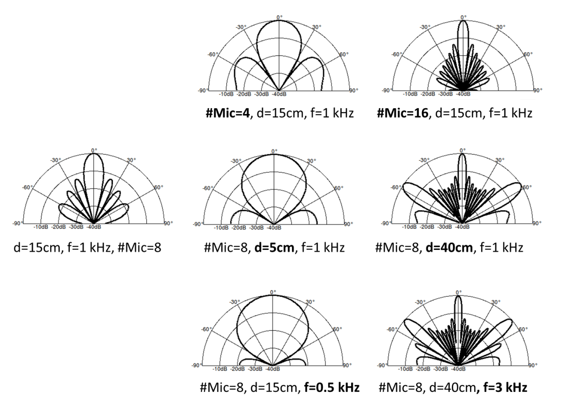
Speech Enhancement
A straightforward way to perform spatial filtering is provided by the delay-and-sum beamforming.
Microphone Array
It simply performs a time alignment followed by a sum of the recorded signals.
Time Delay Estimation
Alignment
Sum
Beamformed Signal

Slide 35
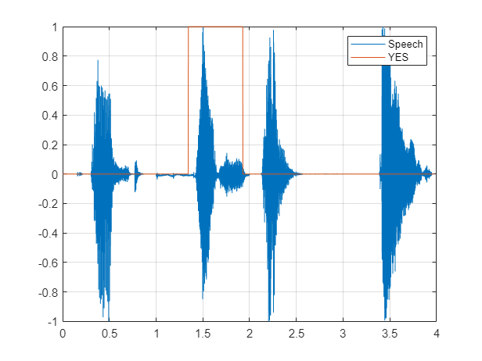
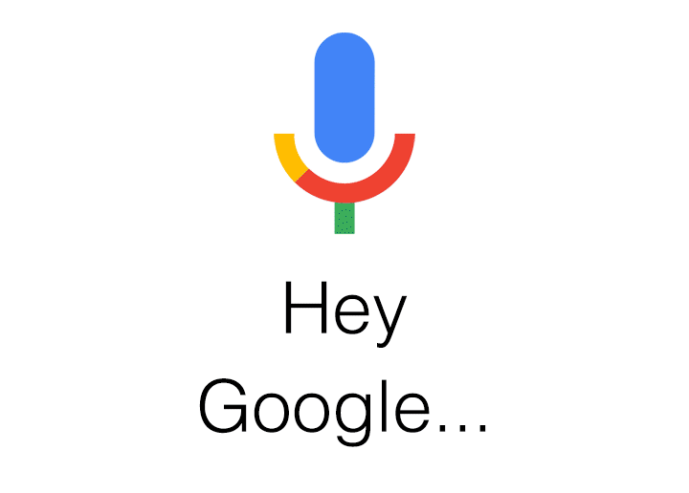


Keyword Spotting
Keyword Spotting aims to detect one or more keywords in a speech recording.
Acoustic Environment
Recording Setup
Voice Activity Detection
Speech Enhancement
Keyword Spotting
Speech Recognition
Acoustic Environment
Generation Setup
Speech Synthesis
Dialogue
Spoken Language Understanding
In speech assistants, keyword spotting is used for wake word detection.
The wake-word triggers for more complex speech processing tasks (e.g., speech recognition, dialogue, etc).

Slide 36
Keyword Spotting
Keyword Spotting aims to detect one or more keywords in a speech recording.
Acoustic Environment
Recording Setup
Voice Activity Detection
Speech Enhancement
Keyword Spotting
Speech Recognition
Common Approaches:
Small neural networks (CNNs, RNNs) trained on standard speech features (e.g, spectrograms, FBANKs, MFCCS).
Acoustic Environment
Generation Setup
Speech Synthesis
Dialogue
Spoken Language Understanding
Challenges:
Being robust against noise and reverberation. Keywords are often pronounced far from the recording device.
Being robust against similar words.
Minimize False Positives and False Negatives
Achieve good performance with a small-footprint model working in real-time.

Slide 37
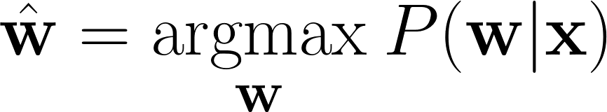
Speech Recognition
Speech Recognition aims to detect the words uttered in a speech recording (speech-to-text)
Acoustic Environment
Recording Setup
Voice Activity Detection
Speech Enhancement
Keyword Spotting
Speech Recognition
It is a sequence-to-sequence learning problem.
Acoustic Environment
Generation Setup
Speech Synthesis
Dialogue
Spoken Language Understanding
We map an input sequence of features x into a sequence of words w:
Challenges:
Robustness against Noise and Reverberation.
Robustness on different accents and spontaneous speech.
Common Approaches:
Neural Networks (e.g., Transformers) coupled with encoder-decoder, CTC, or Transducer Architectures.
Robustness for low-resource languages.

Slide 38
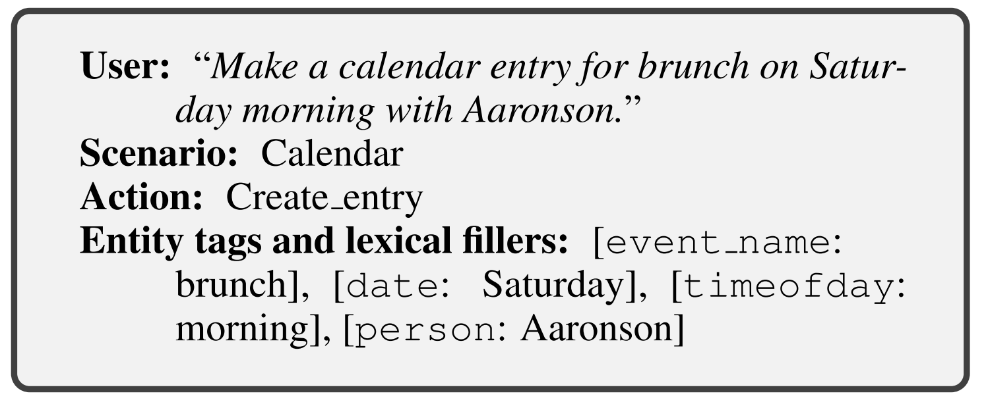
Spoken Language Understanding
Spoken Language Understanding aims to extract the meaning of a spoken sentence.
Acoustic Environment
Recording Setup
Voice Activity Detection
Speech Enhancement
Keyword Spotting
Speech Recognition
The meaning can be used in different ways.
Acoustic Environment
Generation Setup
Speech Synthesis
Dialogue
Spoken Language Understanding
For instance, it can be used to trigger a dialogue system.
It can also be used for intent detection or slot filling :
Challenges:
Ambiguity, Synonyms, Sarcasm
Errors in text or speech
Colloquialisms and slang
Domain-specific language
Low-resource languages
Input
output
In this case, the goal is to fill a predefined semantic ontology.

Slide 39
Dialogue
The dialogue system aims to reply to requests from users.
Acoustic Environment
Recording Setup
Voice Activity Detection
Speech Enhancement
Keyword Spotting
It is the core part of a conversational AI system.
Speech Recognition
Hi, I want to reserve a restaurant today.
Dialogue System
Which kind of food do you want to eat?
Acoustic Environment
Generation Setup
Speech Synthesis
Dialogue
Spoken Language Understanding
Dialogue History
Dialogue systems have different architectures according to their goals (task-oriented and open-domain dialogue systems).
In some cases, the dialogue is implemented with a single neural network (end-to-end dialogue systems)
Often, the dialogue system involves a bunch of submodules (e.g, dialogue state tracker, natural language generation, dialogue management, etc).

Slide 40
Dialogue
The dialogue system aims to reply to requests from users.
Acoustic Environment
Recording Setup
Voice Activity Detection
Speech Enhancement
Keyword Spotting
It is the core part of a conversational AI system.
Speech Recognition
Acoustic Environment
Generation Setup
Speech Synthesis
Dialogue
Spoken Language Understanding
Hi, I want to reserve a restaurant today.
Dialogue System
Which kind of food do you want to eat?
Dialogue History
Challenges:
Data Efficiency Most neural approaches.
Generating reasonable, consistent, and empathetic, engaging responses.
Robustness against speech recognition errors.
Adding common sense knowledge and reasoning.

Slide 41



Speech Synthesis
Speech Synthesis converts a text into a speech signal (text-to-speech).
Acoustic Environment
Recording Setup
Voice Activity Detection
Speech Enhancement
Keyword Spotting
Speech Recognition
Which kind of food do you want to eat?
Speech Synthesis
Acoustic Environment
Generation Setup
Speech Synthesis
Dialogue
Spoken Language Understanding
Deep learning is the dominant approach to speech synthesis.
Challenges:
Generating speech with good prosody (intonation, stress pattern, loudness variations, pausing, and rhythm).
Emotional speech synthesis.
Low-resource languages.
Often, the system is composed of two submodules:
Text
The acoustic model converts text into some speech representation (e.g. spectrogram)
Acoustic Model
Spectrogram
Vocoder
The vocoder converts the speech representation into a waveform
Waveform
speech

Slide 42


Generation Setup
We now want to play the digital speech signal generated by the speech synthesis system.
Acoustic Environment
Recording Setup
Voice Activity Detection
Speech Enhancement
Keyword Spotting
Speech Recognition
This operation is done with a setup that includes the following modules:
Acoustic Environment
Generation Setup
Speech Synthesis
Dialogue
Spoken Language Understanding
Digital Audio
DACs convert finite-precision time series data to a continually varying physical signal.
Digital-to-Analog Conversion (DAC)
One common approach is to use the pulse-width modulator.
It generates a voltage signal whose duration is determined by the digital input code (high digital numbers, longer duration).
A low-pass analog filter is then applied.
Loudspeaker

Slide 43


Generation Setup
The loudspeaker converts an electrical audio signal into a corresponding acoustic wave.
Acoustic Environment
Recording Setup
Voice Activity Detection
Speech Enhancement
Keyword Spotting
Speech Recognition
Loudspeaker systems vary enormously.
Acoustic Environment
Generation Setup
Speech Synthesis
Dialogue
Spoken Language Understanding
Moving coil
Electrostatic

Slide 44

Multiple Interactions
The signal emitted by the loudspeaker is propagated into an acoustic environment.
The ears of the user capture it, and the brain elaborates on it and thinks about a reply.
Acoustic Environment
Recording Setup
Voice Activity Detection
Speech
Enhancement
Keyword Spotting
The user then generates a speech signal again.
Speech Recognition
We iterate over all these modules until the conversation ends
Acoustic Environment
Generation Setup
Speech Synthesis
Dialogue
Spoken Language Understanding

Slide 45
Introduction to SpeechBrain

Slide 46

What is SpeechBrain?
SpeechBrain is an open-source toolkit for conversational AI based on PyTorch.
Goal: speed up research and development of these technologies
Conversational AI requires combining different technologies.
Acoustic Environment
Recording Setup
Speech Enhancement
Voice Activity Detection
Keyword Spotting
SpeechBrain is designed for that!
Speech Recognition
Acoustic Environment
Loudspeaker
Speech Synthesis
Dialogue
Spoken Language Understanding

Slide 47
What is SpeechBrain?
We want a toolkit that, like our brain,
1. recognizes speech
2. understands its content
3. language
4. emotions
5. speakers
6. converses with humans.
Voice Activity Detection
Speech
Recognition
Keyword
Spotting
Spoken Language Understanding
…..
Dialogue
…..

Slide 48
What is SpeechBrain?
SpeechBrain currently supports several tasks, including:
Speech Recognition
Speech Separation
Spoken Language Understanding
Speech Enhancement
Speech Synthesis
Speaker Recognition
Diarization
Beamforming
Speech Translation
Language Modeling
Language Identification
Voice Activity Detection
Grapheme-to-Phoneme
…and many others..

Slide 49




What is SpeechBrain?
Development Started: February 2020
https://speechbrain.github.io/
Public Release: March 2021
Now
137 Contributors
7.1k Stars on GitHub
1.2 Forks
200 training recipes for 23 datasets
> 100 Pretrained models on HuggingFace

Slide 50




What is missing from PyTorch?
One can implement all the modules of a conversational AI system in raw PyTorch directly.
Why using SpeechBrain then?
Community
Models
Recipes
Sequence Learning

Slide 51

Models
SpeechBrain has a large collection of popular models for sequence processing:
ECAPA-TDNN
Conformers
SepFormer
DualPath-RNNs
HiFI-GAN
Wav2vect 2.0
Transformers
ConvTasnet
Tacotron 2
…..
The models can be easily used, modified, and fine-tuned.
>100 Pretrained models on HuggingFace (coupled with easy-inference APIs)
https://huggingface.co/speechbrain

Slide 52
Recipes
What is a recipe?
A recipe is a collection of all the scripts needed to train and evaluate a model on a certain dataset (a concept inherited from Kaldi).
LibriSpeech
WSJMIX
CommonVoice
AMI
Voxceleb
VoiceBank
VoxLingua
SLURP
AISHELL
LJSpeech
IEMOCAP
…
SpeechBrain has 73 training recipes for 23 datasets.

Slide 53





Sequence Learning
SpeechBrain implements a bunch of functionalities to make sequence learning easier
Data Loaders
Data augmentation (on the fly)
JSON/CSV data manifest files
Noise
Reverberation
Speed Perturbation
Time/Frequency Masking
Dynamic-Item Dataset
Dynamic Mixing (speech separation)
WebDataset for huge corpora
Resumable Checkpointings

Slide 54


Sequence Learning
Trainer (Brain Class)
Hyperparameter Specification (HyperPyYAML)
python train.py hparams.yaml

Slide 55

Community
Behind SpeechBrain there is a community of passionate volunteers that share the same interest in Conversational AI technology.
The community helps to:
expand/maintain the toolkit
Implement new models/recipes
solving issues/bugs
We are always looking for new contributors!
speechbrainproject@gmail.com

Slide 56






Sponsors
Sponsors are an important part of our community!

Slide 57




Lab Session
During the weekly lab session, we will do:
Tutorial on Pytorch
Debugging a PyTorch Code
Deadline: January, 23 11.59 pm

Slide 58


